Slide 1
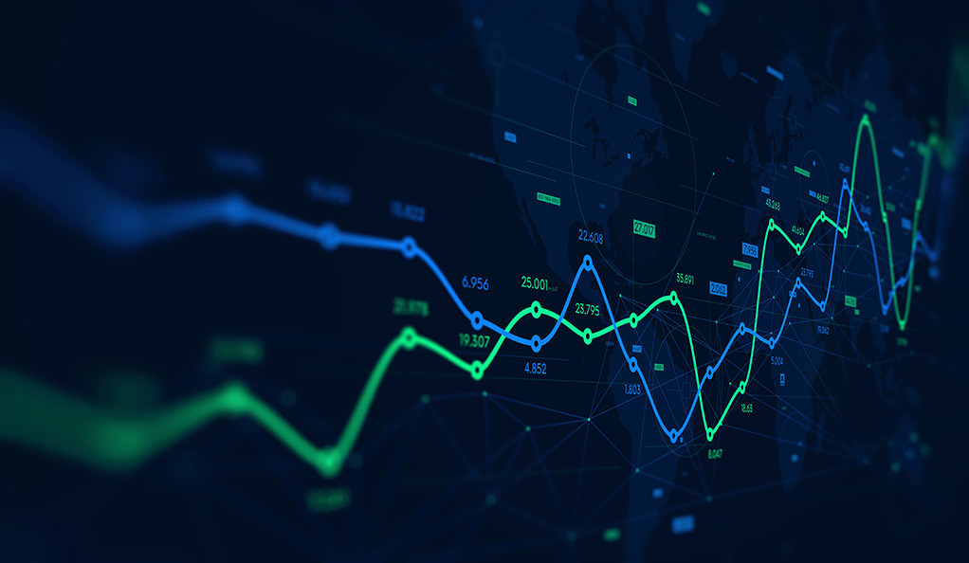
Morning coffee chat with professionals:
Machine Learning in Economics
Hosts: David Zhu, Rahul Kejriwal
Panelists: Noah Yang, Pranay Reddy

Slide 2
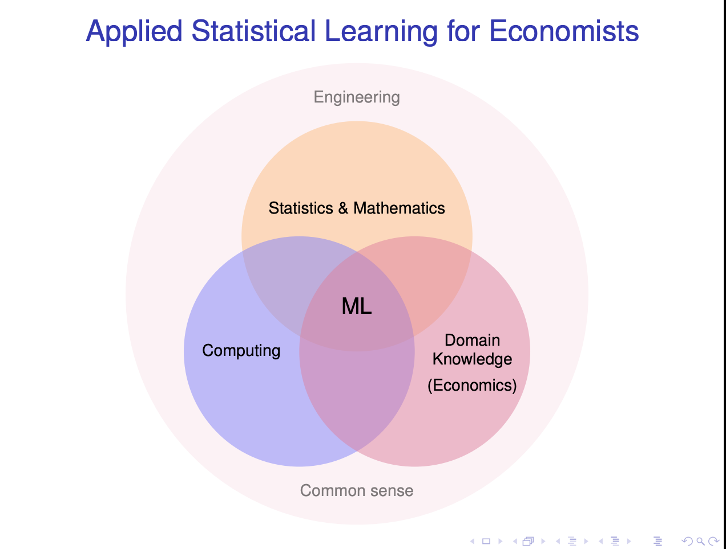

Slide 3
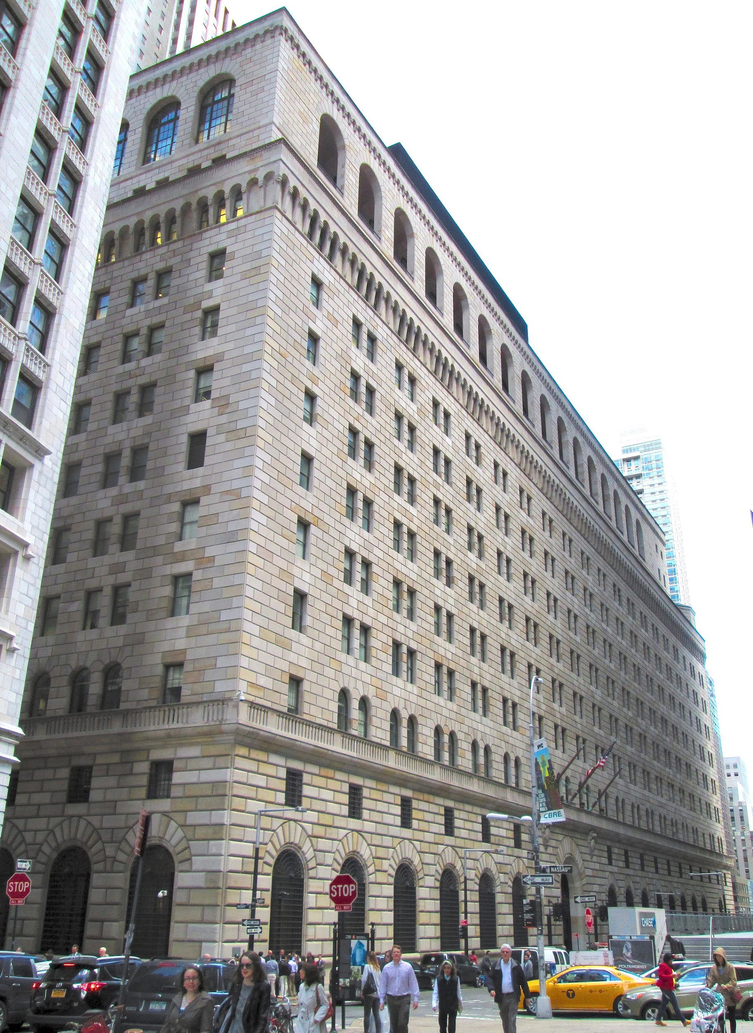
What is it about economics?
Economics: study of utilizing scarce/limited resources
Scarce resources: Almost EVERYTHING
Economic questions: What? How? From whom?
Fields: Almost EVERYWHERE
When do we care: almost ALWAYS
Who’s affected and who affects economics?
Politicians
Policy makers
Business leaders
Times Person of the Year (especially 2006, AKA ‘you’, or EVERYONE)

Slide 4
Why ML in ECON?
Large amount of data
ML strength in large, complex datasets
Economics is related to everything
Increased data collection capacity
Complexity of data
ML in economics

Slide 5

ML Approaches used in economics
Similar to most other ML applications
Modeling approaches
Naive Bayes
Decision tree/random forest
Forward & back propagation
KNN, PCA, SVM, etc.
Feature extraction/engineering
‘Transfer learning’
ANN, CNN
Supervised VS unsupervised
Recent trends & milestones
‘Prediction problem solving’
Causal inference

Slide 6

Examples of ML Applications in ECON
Economics and Finance
Crisis Prediction
Default Detection
Forecasting (Equity, Forex)
Risk Analysis and Management
Fraud transaction detection
Socioeconomics

Slide 7
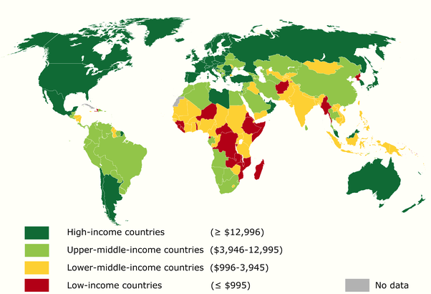
Socioeconomic concerns
Wealth Gap
Uneven distribution
Geographic differences
Poverty
Lack of infrastructure
Malnutrition
Low literacy
Poor health access
Conflicts & violent crimes
Africa

Slide 8
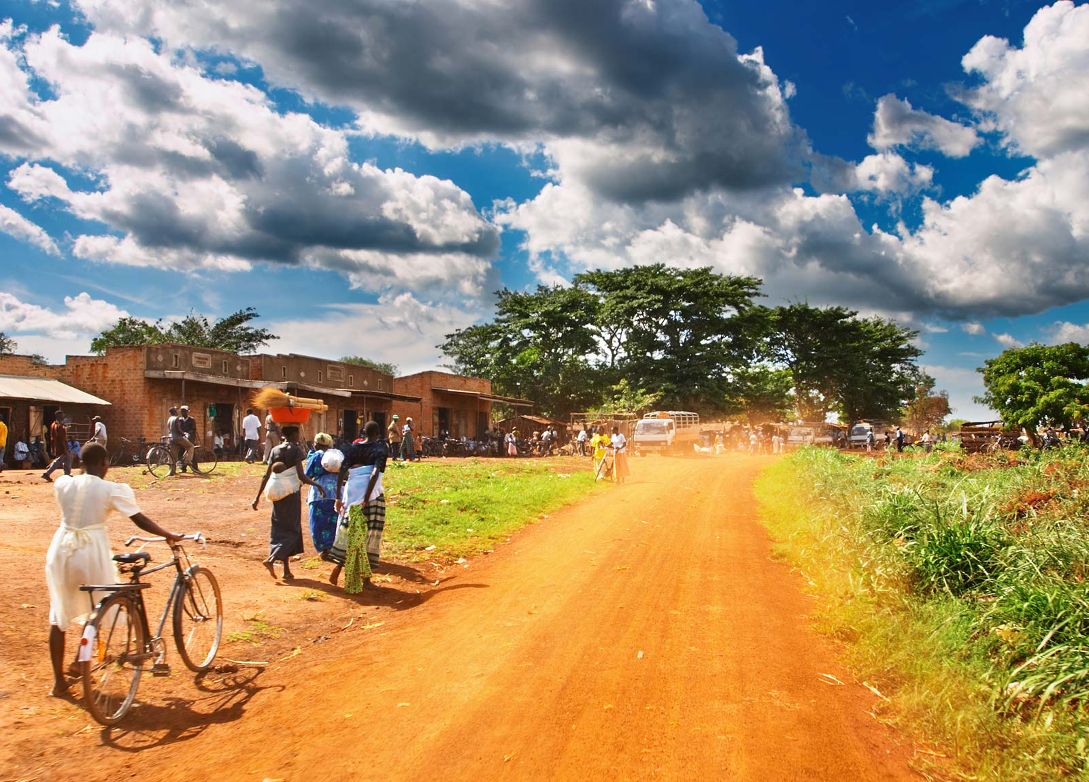
How can machine learning help Africa
Pranay Reddy & Noah Yang

Slide 9
Issues to be addressed in Africa’s economy
Agriculture - Helping predict oncoming droughts and underperforming crops.
Healthcare - Shortening self-diagnosis times by artificially intelligent mobile question-answering services, to help reduce the number of deaths.

Slide 10
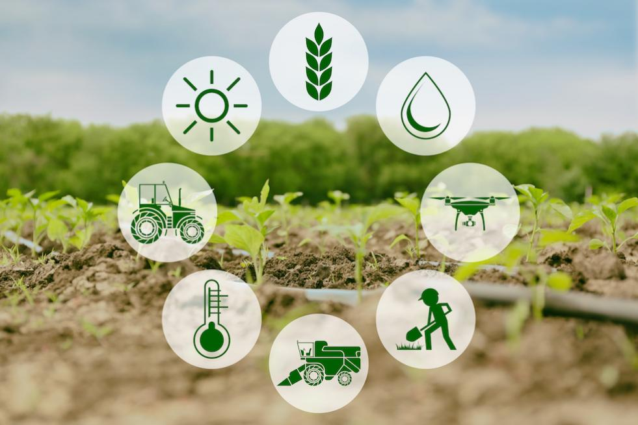
How Machine Learning can help agriculture in Africa
Being able to analyze and predict weather and crop-related data to reveal drought on the horizon, will help farmers skip a planting season and save millions of US dollars in input costs.
More specifically, the technology has the capability of forecasting underperforming crops in African countries and situations that will call for an international convention.

Slide 11
Using Artificial Neural Network to predict Weather
The parameters required to predict the weather are enormously complex such that there is uncertainty in prediction even for a short period.
The property of artificial neural networks is that they not only analyze the historical data, but also learn from it for future predictions make them suitable / ideal for weather forecasting.
Weather prediction can be simplified by using the artificial neural networks (ANN) with back propagation for supervised learning using the data collected at a particular station at a specified period.

Slide 12
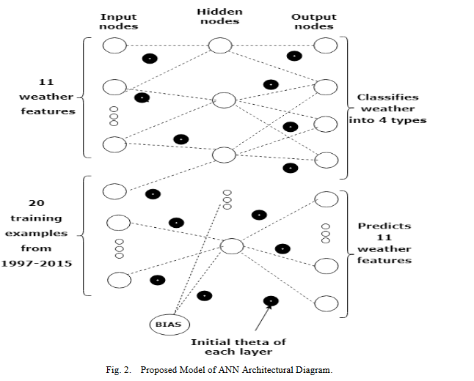
How Artificial Neural Networks work
Just like a human brain, ANN needs neurons to perform the action in hidden layers.
An ANN network contains of an input layer, a hidden layer and an output layer.
To build a good model, an ANN needs large amount of data and a number of hidden layers.
Some activation functions like softmax, sigmoid, relu, improve the evaluation of models and decreases the error in predictions.
A neural network which is made up of processing units has a natural ability to store knowledge

Slide 13

How Machine Learning Can help Healthcare in Africa
Machine learning can extract valuable insights from unstructured data like clinical notes and academic journals to provide even larger datasets that will transform the medical industry into a proactive front against diseases.
With the help of ML techniques including XGboost, linear regression and support vector machines we can predict how prone an individual is to a certain disease such as diabetes, heart disease and others.

Slide 14
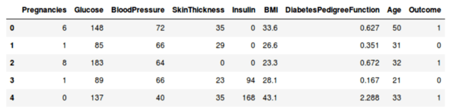
Predicting Diabetes with Logistic Regression
Logistic regression is a statistical method for analyzing a dataset in which there are one or more independent variables that determine an outcome. In this case usually the outcome is binary meaning there are only two possible outcomes.
Based on factors like blood pressure, body mass index, age,etc we can train the model to understand the thresholds of each of these factors and determine whether or not a person is prone or has a high risk of diabetes.

Slide 15
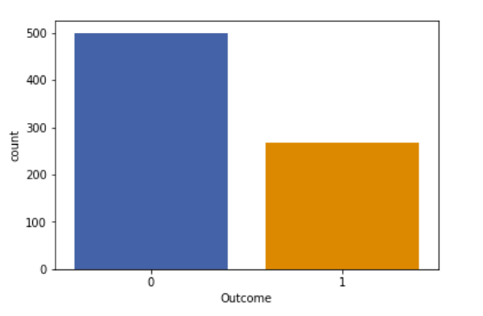
Outcome of the predicted model
Barplot visualization of number of non-diabetic (0) and diabetic (1) people in the dataset

Slide 16

Predicting Poverty and Wealth from Mobile Phone Metadata
Geographic Distribution of Poverty & Wealth is Important
Developing Countries Lack Reliable Quantitative Data
Unreliable Public Data
Cost of National Household Survey
Solution
Mobile Phone Data!

Slide 17
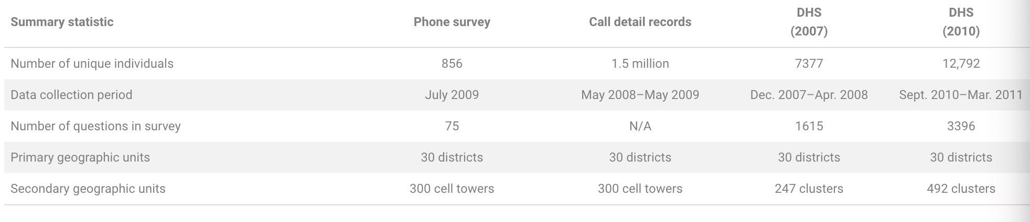
Dataset
Rwanda

Slide 18
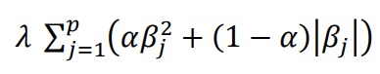
Method
Baseline Method
Linear Regression
Elastic Net Regularization
Intuitive Model - Mobile Phone Metadata
Feature Engineering
Deterministic Finite Automaton (DFA)

Slide 19
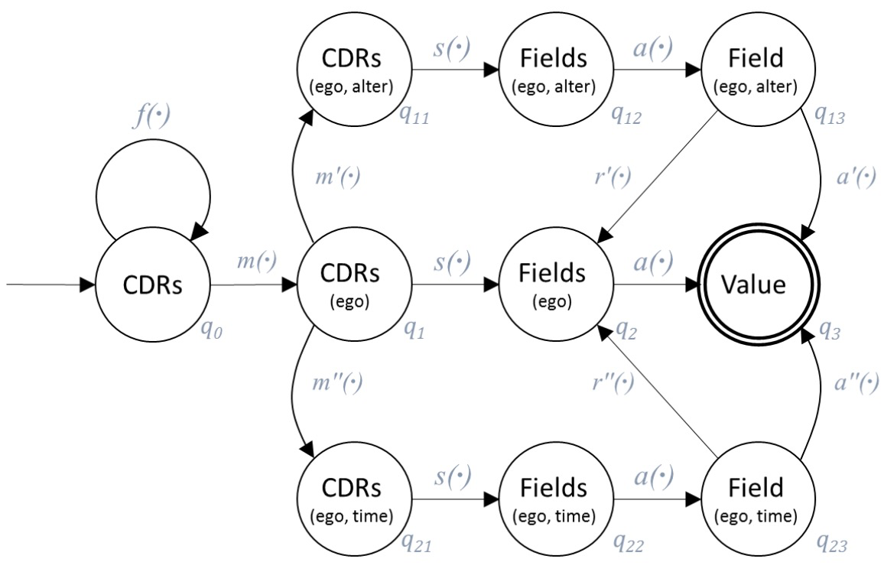
DFA

Slide 20
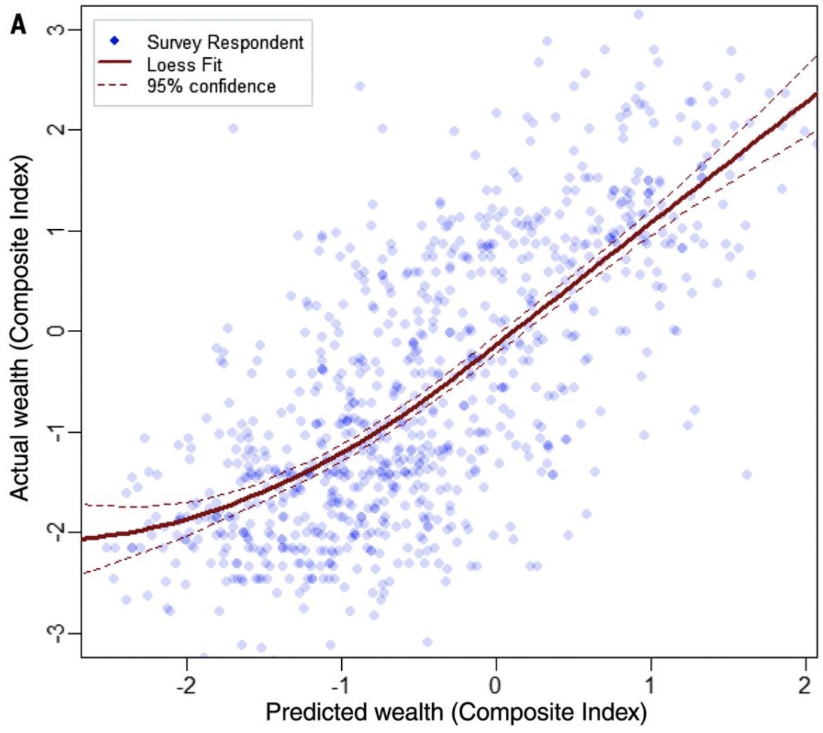

Slide 21
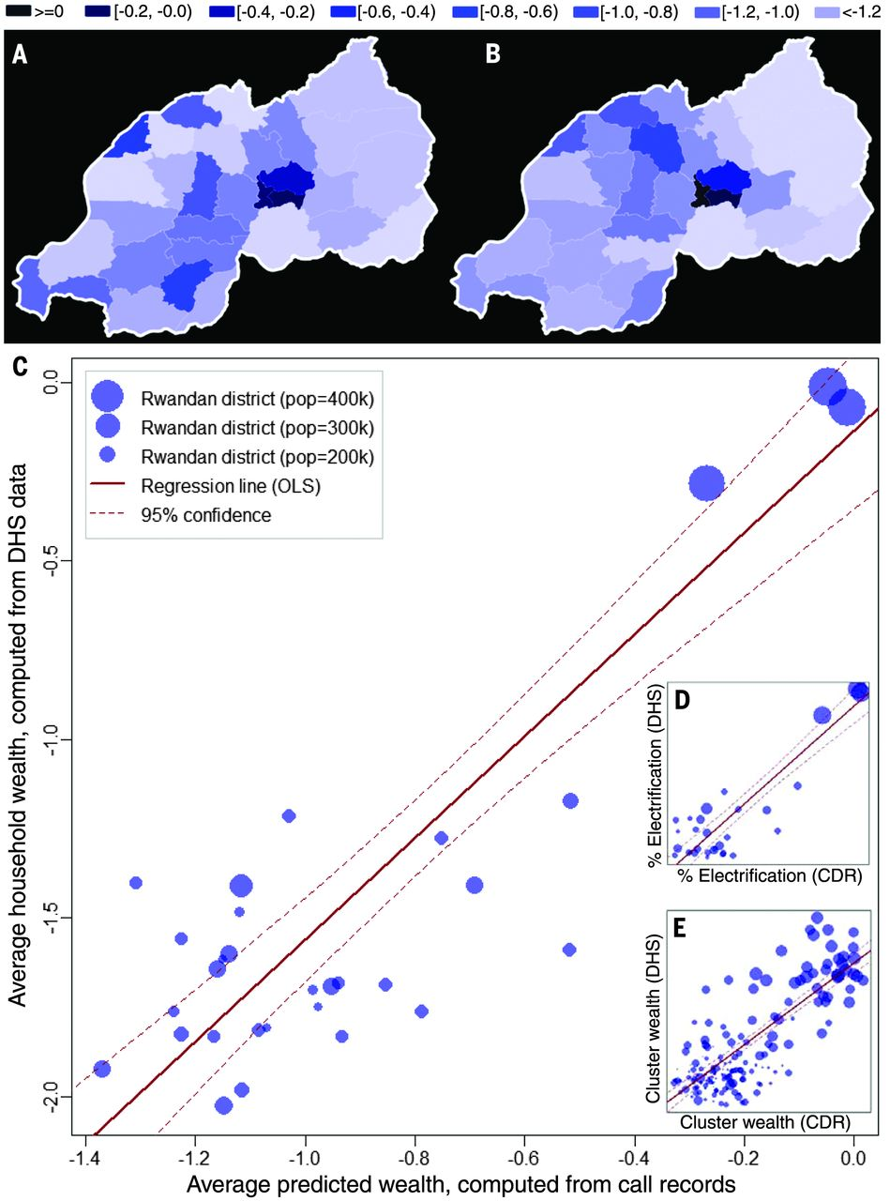

Slide 22

Limitation & Future Work
Limitation
Data Privacy
Future Work
Fundamental Work

Slide 23
Summary
Through weather predictions and predicting low performing crop seasons, Africa can save about 12 million dollars a year in input costs.
In places where the healthcare system is broken and there are very few doctors, decreasing the time of diagnosis can help prevent deaths and the costs deaths have on the economy.
A typical national household survey costs more than $1 million and requires 12 to 18 months to complete, the phone survey we conducted cost only $12,000 and took 4 weeks to administer.

Slide 24
Conclusion
This presentation highlights how machine learning could be used to solve challenges that African continent is facing.
Each of identified challenge is discussed and a machine learning technique that can be used to address it is highlighted in great detail.
Advanced economies are already using machine learning to solve problems like traffic congestion, saving cows from bad drivers and improving healthcare, while Africa lags conspicuously behind.
African leaders may be aware of this. Whether they possess the foresight to see people through is however debatable

Slide 25
References
Geetha, Angelina and G. M. Nasira. “Artificial Neural Networks' Application in Weather Forecasting - Using RapidMiner.” (2014).
Predicting poverty and wealth from mobile phone metadata By Joshua Blumenstock, Gabriel Cadamuro, Robert On Science 27 Nov 2015 : 1073-1076
Elisa, Noe. (2018). Could Machine Learning be used to address Africa’s Challenges?. International Journal of Computer Applications. 180. 9-12. 10.5120/ijca2018916411.
Athey, S. (Jan 2018). Stanford University. The Impact of Machine Learning on Economics.

Slide 26
Thank you
Any Questions?

